Slide 1
SVELTE KIT weather app
By Gaby, Alexis & Margot

Slide 2
What is Svelte KIT
Difference between Svelte & Svelte Kit is that Svelte is like React & Svelte Kit is like NextJS
It is a framework to build high-performance web apps
Each of the pages is a Svelte component
We create page by adding it in « routes » folder

Slide 3
Why have we done a weather app?
Small application that still requires enough design and code in order to properly work
Finishable in 1 day
Easiest idea that we got
Comparing to other ideas (cookies clicker, card game, tictactoe, mineswiper, etc), it seemed the most reasonable one
A challenge for everyone: Gaby had to manage the complete day, Alexis had to design an actual app and think about features & Margot had to learn a new language and create the app
It made it possible to help each other within the small time frame we had without losing sight of the application, meaning we got to work on our own things but still help each other

Slide 4
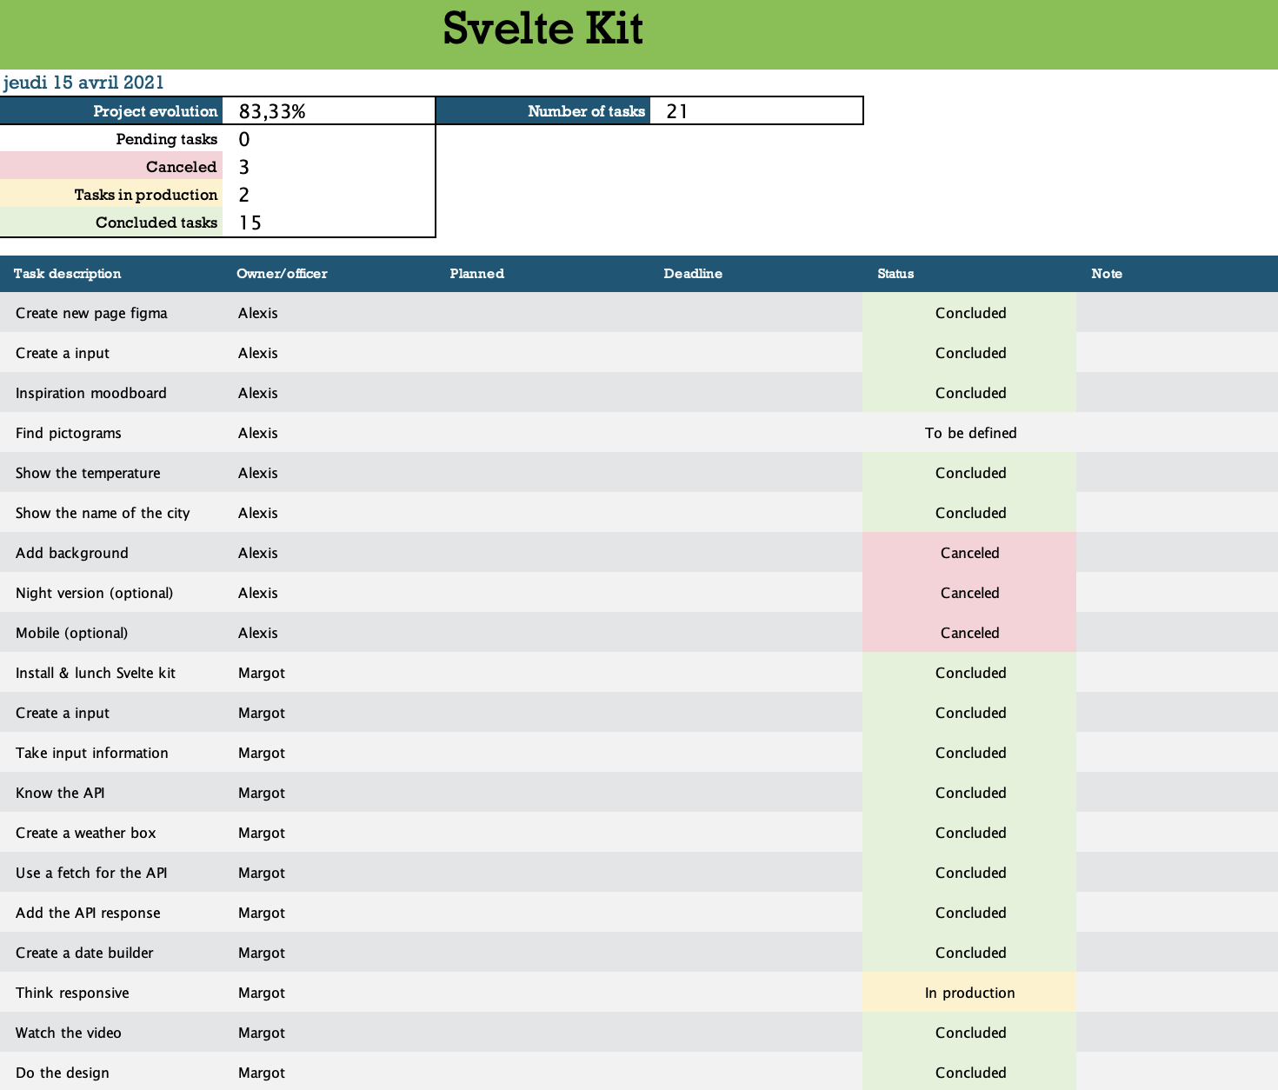
What did we use to manage the project? Why?
We used Excel because it’s a small project
Once the template done, Excel is easy to use
You can do whatever you want

Slide 5
Now, the app presentation

Slide 6
Why did we use Figma
It’s collaborative
It’s user friendly (e.g. plugins)
It’s free access up to 3 projects
It’s a hybrid app
Margot has experience with it, so she can help easily

Slide 7
What kind of difficulties did you face during the project, Alexis?
Have an appropriate workflow
Style guide creation (colors, fonts)
A lot of things to think about

Slide 8
And what did it bring you ?
Discover a totally different world than mine
Some tools and tips to create the style
Understanding why Margot is so... voilà

Slide 9
What kind of difficulties did you face during the project, Margot?
Learning Svelte Kit without knowing Svelte
Trying to do learn it all in 1 day
In the beginning, the syntax, now it's quite easy to understand
When there's a bug, trying to fix it and try like 1000 different things
The constant trial and error

Slide 10
And what did it bring you ?
It's fun to be a developer
It requires patience and a good google search skill
It’s completely the opposite of designing

Slide 11
What kind of difficulties did you face during the project, Gaby?
Not help too much
Giving « orders »
Respect the time (it’s so hard)
Talking in english, sometimes I don’t have the right words
The pression to finish the work because I’m the project manager and if it’s not finished in time, it’s totally my fault

Slide 12
And what did it bring you ?
Confidence to talk in english with Margot
Cohesion with my team
It was fun but I prefer to be a developer

Slide 13
Some questions?

Slide 14
Thank’s for Listening

